Slide 1


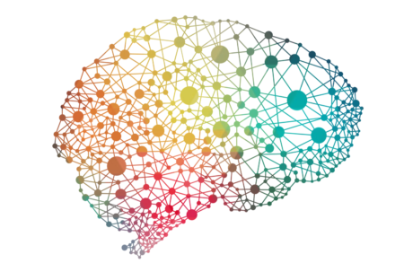
“EEG functional connectivity and complexity for the evaluation of physiological and pathological brain states”
PhD Student: Alessia Cacciotti
Brain Connectivity Laboratory, Department of Neuroscience and Neurorehabilitation, IRCCS San Raffaele Roma, Rome, Italy
Department of Theoretical and Applied Sciences, eCampus University, Novedrate, Como, Italy

Slide 2

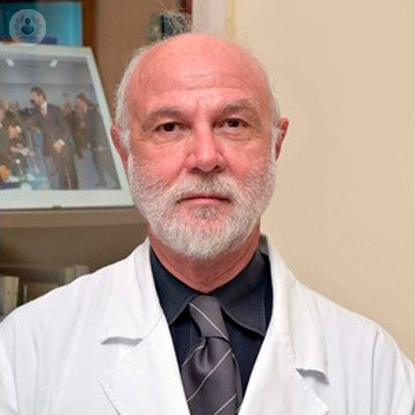
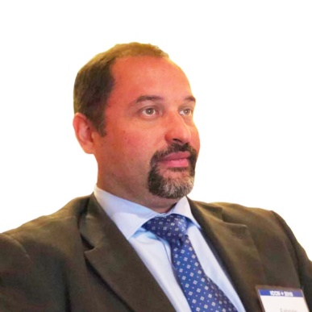
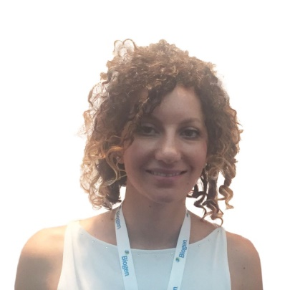
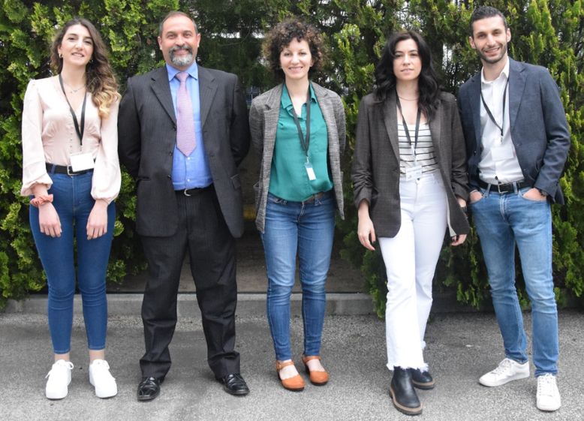

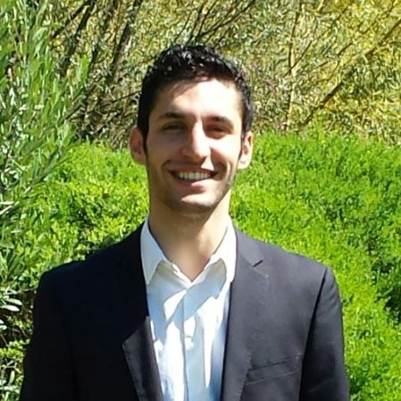

BCLAB Brain Connectivity LABoratory
for cognitive neurosciences
Prof. Paolo Maria Rossini, PhD
Prof. Fabrizio Vecchio, PhD, Eng
Dr. Francesca Miraglia, PhD, Eng
Dr. Chiara Pappalettera
PhD Student
Dr. Lorenzo Nucci
PhD Student
Dr. Alessia Cacciotti
PhD Student

Slide 3

My PhD Project
“Innovative EEG biomarkers and machine learning algorithms for the evaluation of physiological and pathological aging”
Aging is the main risk factor for the appearance of neurodegenerative diseases, such as Alzheimer’s Disease (AD). Since it is a non-curable disease, many research in the last few years focused on the prodromal state of the AD, the Mild Cognitive Impairment (MCI) condition that occurs with memory reduction that doesn’t fulfil the definition of dementia.
The present project aims to:
identify innovative biomarkers from the analysis of EEG signals in terms of functional connectivity and complexity measures for the evaluation of physiological and pathological aging;
implement machine learning algorithms for studying what features are more predictive in computing brain age and which are more predictive in distinguishing physiological state respect to pathological one.

Slide 4

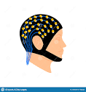

Methods
Participants
120 healthy volunteers will be enrolled and divided respect to their age in three groups: Young (18-40 years old, 40 participants), Adult (41-60 years old, 40 participants) and Elderly (>61 years old, 40 participants).
Moreover, 40 MCI subjects and 40 AD patients age- sex- and education-matched will be recruited.
EEG
Participants will undergo to 5 minutes of resting state EEG recording, both in eyes open and eyes closed conditions.
Neuropsychological tests
Healthy elderlies, MCI subjects and AD patients will be submitted to some neurophysiological tests, such as Mini Mental State Evaluation (MMSE), Instrumental activities daily living (IADL), Clinical Dementia Rating (CDR), Rey Auditory Verbal Learning, Stroop test.

Slide 5

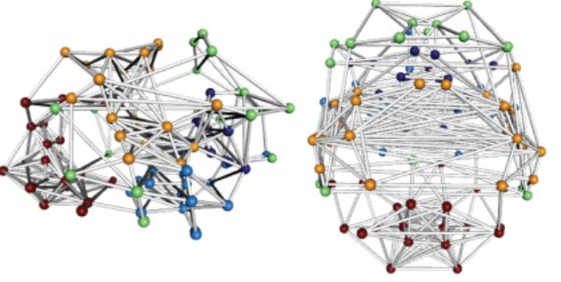
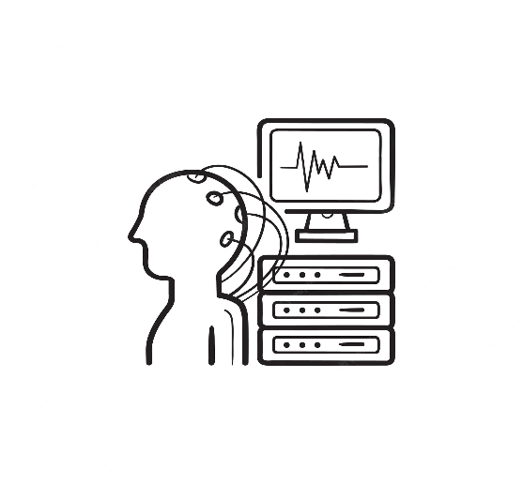
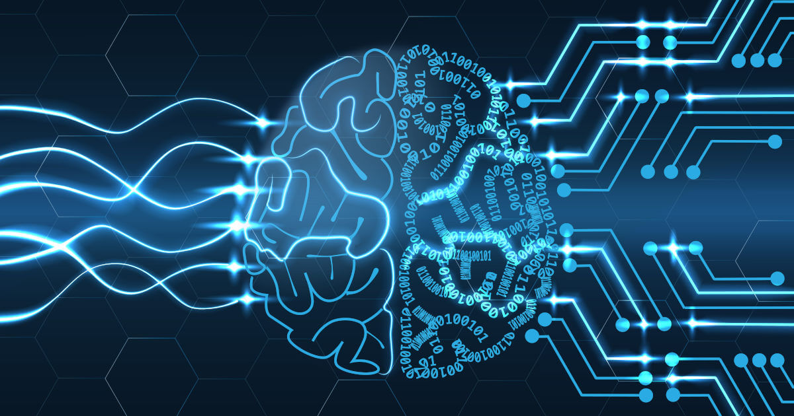

Methods
Young
Adult
EEG
Elderly
Functional Connectivity
Healthy Elderly
Machine Learning
Algorithms
MCI
EEG data will be fragmented in epochs, identifying and extracting visible artifacts.
Entropy
AD
Functional connectivity will be calculated at EEG sources’ and at electrodes’ level; one values of entropy will be obtained for each recording channel.
Different type of classifier (i.e. SVM, k-NN, ANN, logistic regression, Bayesian) will be implemented and tested. The classifier who reaches the best classification performances will be selected.

Slide 6
Significance and prospectives
This research could lead to the realization of a multimodal, low-cost and non-invasive approach reaching high accuracy to early detect brain alterations and pathological conditions (MCI, AD) to plan early rehabilitative interventions, improving patients’ quality of life and reducing health and social costs for dementia management.
The results of the present project might be useful to start additional projects for implementation of a classifier that quantifies the risk of conversion from MCI to AD condition.

Slide 7


E-mail:
Fabrizio Vecchio: fabrizio.vecchio@uniecampus.it
fabrizio.vecchio@sanraffaele.it
Alessia Cacciotti: alessiacacciotti1997@gmail.com
Availability for collaborations!

